Slide 1
Euler’s Totient Theorem relates modulus of the exponent to that of the base
INSERT
VIDEO
HERE

Slide 2

Euler’s Totient Theorem relates modulus of the exponent to that of the base
$$x^{a}≡x^{a mod φ(N)}\left(mod N\right)$$
INSERT
VIDEO
HERE

Slide 3

Euler’s Totient Theorem relates modulus of the exponent to that of the base
$$x^{a}≡x^{a mod φ(N)}\left(mod N\right)$$
Euler’s Totient Function$: φ\left(N\right)$
INSERT
VIDEO
HERE

Slide 4
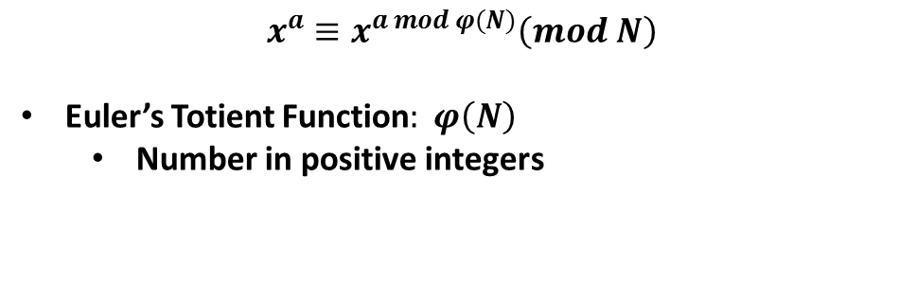
Euler’s Totient Theorem relates modulus of the exponent to that of the base
$$x^{a}≡x^{a mod φ(N)}\left(mod N\right)$$
Euler’s Totient Function$: φ\left(N\right)$
Number in positive integers
INSERT
VIDEO
HERE

Slide 5
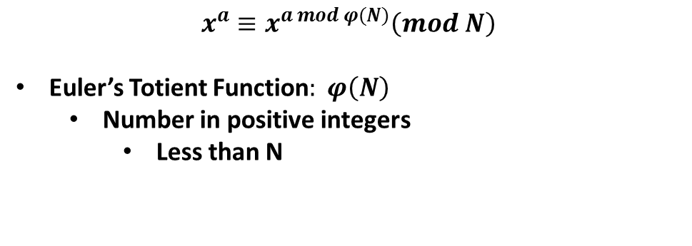
Euler’s Totient Theorem relates modulus of the exponent to that of the base
$$x^{a}≡x^{a mod φ(N)}\left(mod N\right)$$
Euler’s Totient Function$: φ\left(N\right)$
Number in positive integers
Less than N
INSERT
VIDEO
HERE

Slide 6
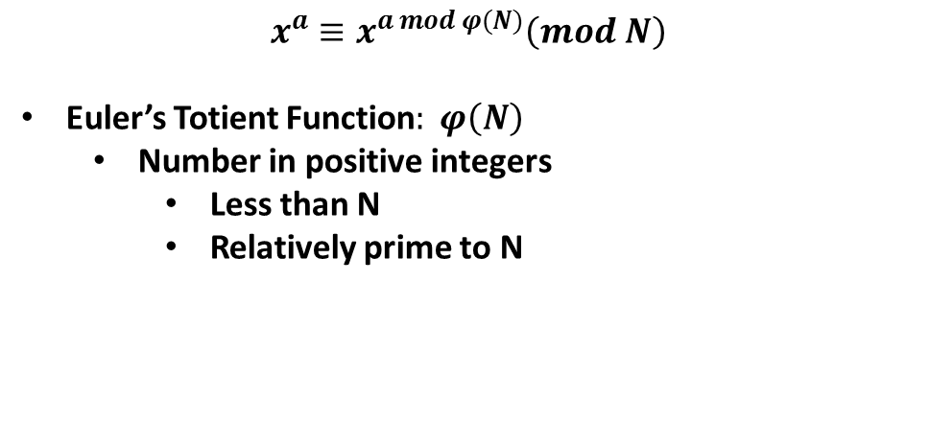
Euler’s Totient Theorem relates modulus of the exponent to that of the base
$$x^{a}≡x^{a mod φ(N)}\left(mod N\right)$$
Euler’s Totient Function$: φ\left(N\right)$
Number in positive integers
Less than N
Relatively prime to N
INSERT
VIDEO
HERE

Slide 7
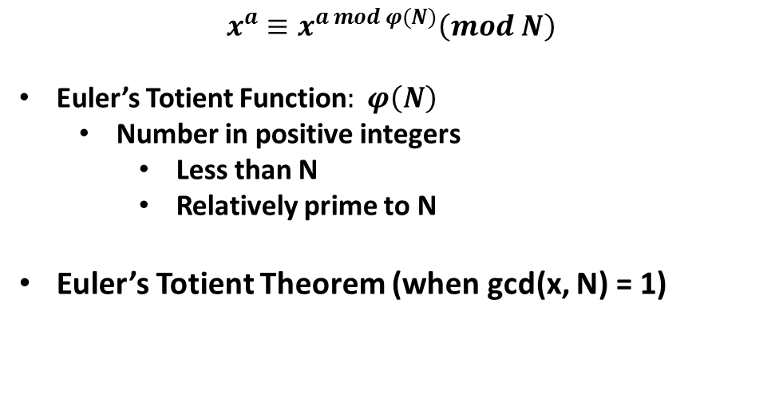
Euler’s Totient Theorem relates modulus of the exponent to that of the base
$$x^{a}≡x^{a mod φ(N)}\left(mod N\right)$$
Euler’s Totient Function$: φ\left(N\right)$
Number in positive integers
Less than N
Relatively prime to N
Euler’s Totient Theorem (when gcd(x, N) = 1)
INSERT
VIDEO
HERE

Slide 8
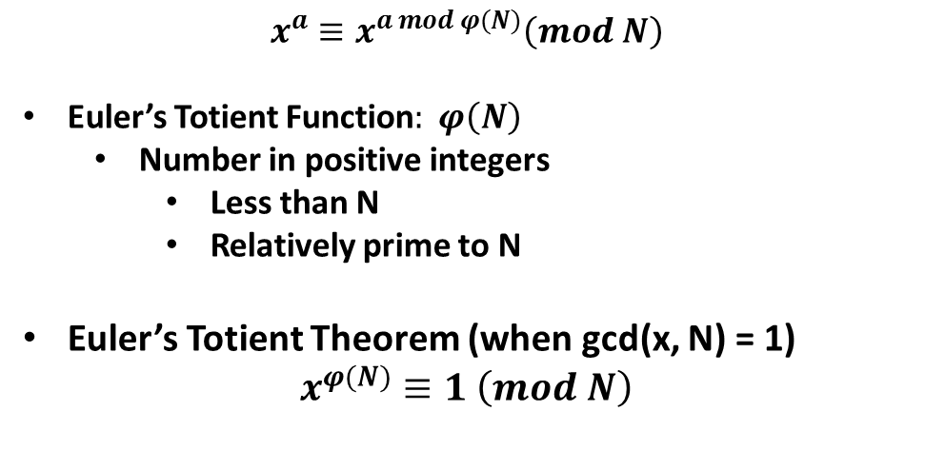
Euler’s Totient Theorem relates modulus of the exponent to that of the base
$$x^{a}≡x^{a mod φ(N)}\left(mod N\right)$$
Euler’s Totient Function$: φ\left(N\right)$
Number in positive integers
Less than N
Relatively prime to N
Euler’s Totient Theorem (when gcd(x, N) = 1)
$$x^{φ(N)}≡1 \left(mod N\right)$$
INSERT
VIDEO
HERE

Slide 9
Euler’s Totient Theorem only applies to bases relatively prime to modulus
INSERT
VIDEO
HERE

Slide 10

Euler’s Totient Theorem only applies to bases relatively prime to modulus
$$x^{φ(N)}≡1 \left(mod N\right)$$
INSERT
VIDEO
HERE

Slide 11

Euler’s Totient Theorem only applies to bases relatively prime to modulus
$$x^{φ(N)}≡1 \left(mod N\right)$$
x and N must be relatively prime!
INSERT
VIDEO
HERE

Slide 12
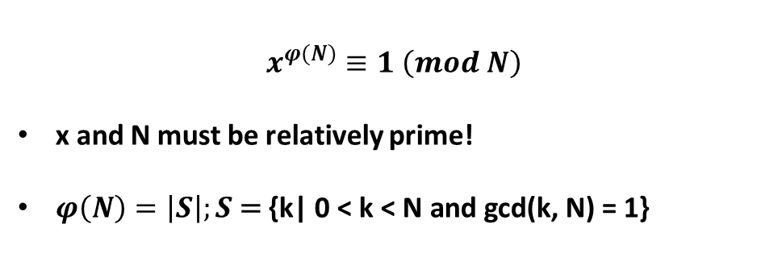
Euler’s Totient Theorem only applies to bases relatively prime to modulus
$$x^{φ(N)}≡1 \left(mod N\right)$$
x and N must be relatively prime!
$φ\left(N\right)=\left|S\right|;S\text{ = }\text{\{}\text{k}\text{| 0 < }\text{k}\text{ < }\text{N} \text{and} \text{gcd}\text{(}\text{k}\text{,} \text{N}\text{) = 1\}}$
INSERT
VIDEO
HERE

Slide 13
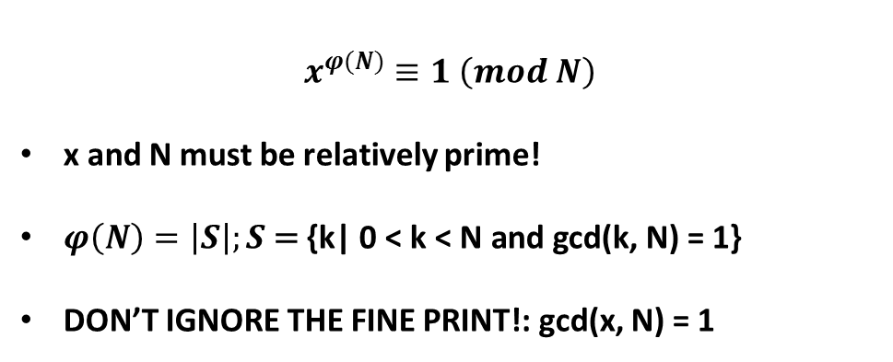
Euler’s Totient Theorem only applies to bases relatively prime to modulus
$$x^{φ(N)}≡1 \left(mod N\right)$$
x and N must be relatively prime!
$φ\left(N\right)=\left|S\right|;S\text{ = }\text{\{}\text{k}\text{| 0 < }\text{k}\text{ < }\text{N} \text{and} \text{gcd}\text{(}\text{k}\text{,} \text{N}\text{) = 1\}}$
DON’T IGNORE THE FINE PRINT!: gcd(x, N) = 1
INSERT
VIDEO
HERE

Slide 14
5^{tot(12)} mod 21 = 1
INSERT
VIDEO
HERE

Slide 15
5^{tot(12)} mod 21 = 1
N = 21
INSERT
VIDEO
HERE

Slide 16
5^{tot(12)} mod 21 = 1
N = 21
S = {1, 2, 4, 5, 8, 10, 11, 13, 16, 17, 19, 20}
INSERT
VIDEO
HERE

Slide 17
5^{tot(12)} mod 21 = 1
N = 21
S = {1, 2, 4, 5, 8, 10, 11, 13, 16, 17, 19, 20}
|S| = 12
INSERT
VIDEO
HERE

Slide 18
5^{tot(12)} mod 21 = 1
N = 21
S = {1, 2, 4, 5, 8, 10, 11, 13, 16, 17, 19, 20}
|S| = 12
x = 5
INSERT
VIDEO
HERE

Slide 19
5^{tot(12)} mod 21 = 1
N = 21
S = {1, 2, 4, 5, 8, 10, 11, 13, 16, 17, 19, 20}
|S| = 12
x = 5
5¹ ≡ 5 (mod 21)
INSERT
VIDEO
HERE

Slide 20
5^{tot(12)} mod 21 = 1
N = 21
S = {1, 2, 4, 5, 8, 10, 11, 13, 16, 17, 19, 20}
|S| = 12
x = 5
5¹ ≡ 5 (mod 21)
5² ≡ 25 ≡ 4 (mod 21)
INSERT
VIDEO
HERE

Slide 21
5^{tot(12)} mod 21 = 1
N = 21
S = {1, 2, 4, 5, 8, 10, 11, 13, 16, 17, 19, 20}
|S| = 12
x = 5
5¹ ≡ 5 (mod 21)
5² ≡ 25 ≡ 4 (mod 21)
5⁴ ≡ 16 (mod 21)
INSERT
VIDEO
HERE

Slide 22
5^{tot(12)} mod 21 = 1
N = 21
S = {1, 2, 4, 5, 8, 10, 11, 13, 16, 17, 19, 20}
|S| = 12
x = 5
5¹ ≡ 5 (mod 21)
5² ≡ 25 ≡ 4 (mod 21)
5⁴ ≡ 16 (mod 21)
5⁸ ≡ 256 ≡ 4 (mod 21)
INSERT
VIDEO
HERE

Slide 23
5^{tot(12)} mod 21 = 1
N = 21
S = {1, 2, 4, 5, 8, 10, 11, 13, 16, 17, 19, 20}
|S| = 12
x = 5
5¹ ≡ 5 (mod 21)
5² ≡ 25 ≡ 4 (mod 21)
5⁴ ≡ 16 (mod 21)
5⁸ ≡ 256 ≡ 4 (mod 21)
5¹² ≡ 5⁸·5⁴ ≡ 4·16 ≡ 63 ≡ 1 (mod 21)
INSERT
VIDEO
HERE

Slide 24
6^{tot(12)} mod 21 ≠ 1
INSERT
VIDEO
HERE

Slide 25
6^{tot(12)} mod 21 ≠ 1
N = 21
S = {1, 2, 4, 5, 8, 10, 11, 13, 16, 17, 19, 20}
|S| = 12
x = 6
6¹ ≡ 6 (mod 21)
6² ≡ 36 ≡ 15 (mod 21)
6⁴ ≡ 225 ≡ 15(mod 21)
6⁸ ≡ 225 ≡ 15 (mod 21)
6¹² ≡ 6⁸·6⁴ ≡ 15·15 ≡ 225 ≡ 15 (mod 21)
INSERT
VIDEO
HERE

Slide 26
A proof in eight (mostly) simple steps
INSERT
VIDEO
HERE

Slide 27
A proof in eight (mostly) simple steps
S = $\text{\{}\text{k}\text{| 0 < }\text{k}\text{ < }\text{N} \text{and} \text{gcd}\text{(}\text{k}\text{, }\text{N}\text{) = 1\}}$
INSERT
VIDEO
HERE

Slide 28
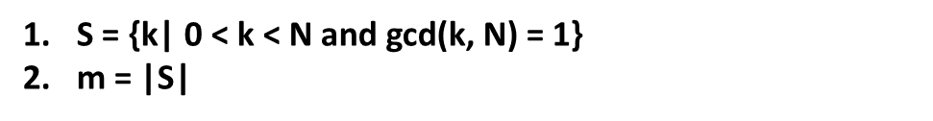
A proof in eight (mostly) simple steps
S = $\text{\{}\text{k}\text{| 0 < }\text{k}\text{ < }\text{N} \text{and} \text{gcd}\text{(}\text{k}\text{, }\text{N}\text{) = 1\}}$
m = |S|
INSERT
VIDEO
HERE

Slide 29
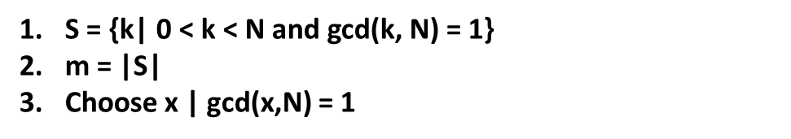
A proof in eight (mostly) simple steps
S = $\text{\{}\text{k}\text{| 0 < }\text{k}\text{ < }\text{N} \text{and} \text{gcd}\text{(}\text{k}\text{, }\text{N}\text{) = 1\}}$
m = |S|
Choose x | gcd(x,N) = 1
INSERT
VIDEO
HERE

Slide 30
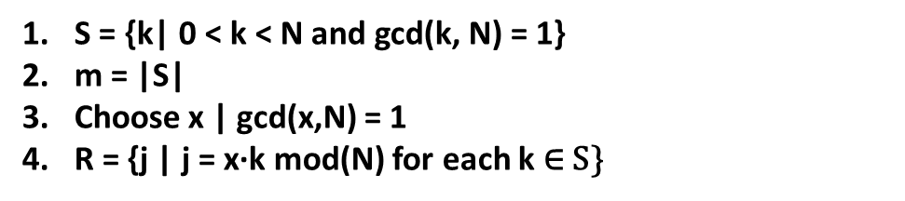
A proof in eight (mostly) simple steps
S = $\text{\{}\text{k}\text{| 0 < }\text{k}\text{ < }\text{N} \text{and} \text{gcd}\text{(}\text{k}\text{, }\text{N}\text{) = 1\}}$
m = |S|
Choose x | gcd(x,N) = 1
R = {j | j = x·k mod(N) for each k ∈ S}
INSERT
VIDEO
HERE

Slide 31
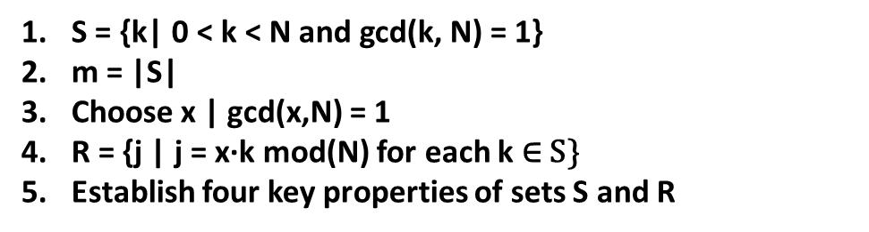
A proof in eight (mostly) simple steps
S = $\text{\{}\text{k}\text{| 0 < }\text{k}\text{ < }\text{N} \text{and} \text{gcd}\text{(}\text{k}\text{, }\text{N}\text{) = 1\}}$
m = |S|
Choose x | gcd(x,N) = 1
R = {j | j = x·k mod(N) for each k ∈ S}
Establish four key properties of sets S and R
INSERT
VIDEO
HERE

Slide 32
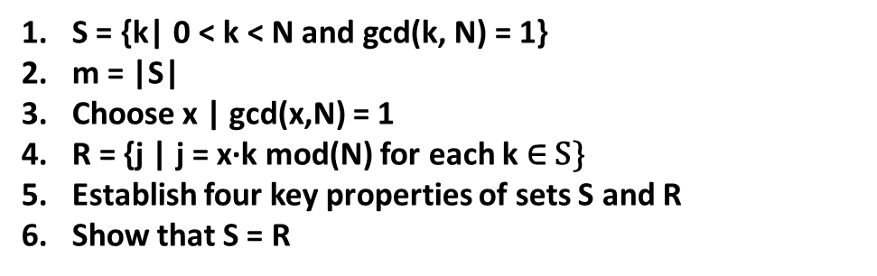
A proof in eight (mostly) simple steps
S = $\text{\{}\text{k}\text{| 0 < }\text{k}\text{ < }\text{N} \text{and} \text{gcd}\text{(}\text{k}\text{, }\text{N}\text{) = 1\}}$
m = |S|
Choose x | gcd(x,N) = 1
R = {j | j = x·k mod(N) for each k ∈ S}
Establish four key properties of sets S and R
Show that S = R
INSERT
VIDEO
HERE

Slide 33
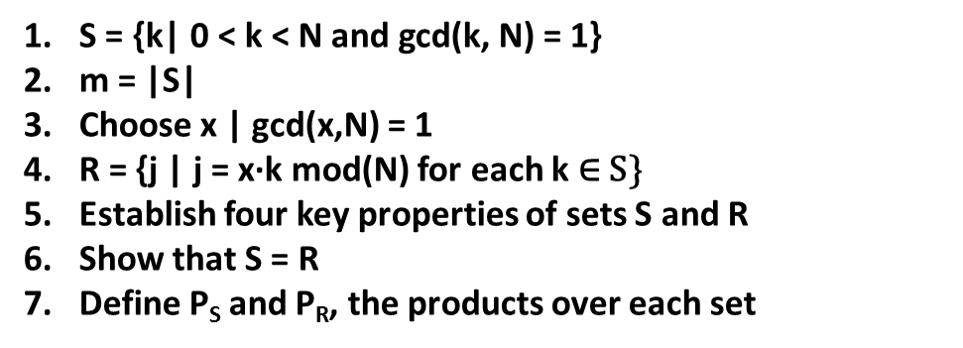
A proof in eight (mostly) simple steps
S = $\text{\{}\text{k}\text{| 0 < }\text{k}\text{ < }\text{N} \text{and} \text{gcd}\text{(}\text{k}\text{, }\text{N}\text{) = 1\}}$
m = |S|
Choose x | gcd(x,N) = 1
R = {j | j = x·k mod(N) for each k ∈ S}
Establish four key properties of sets S and R
Show that S = R
Define P_{S} and P_{R}, the products over each set
INSERT
VIDEO
HERE

Slide 34
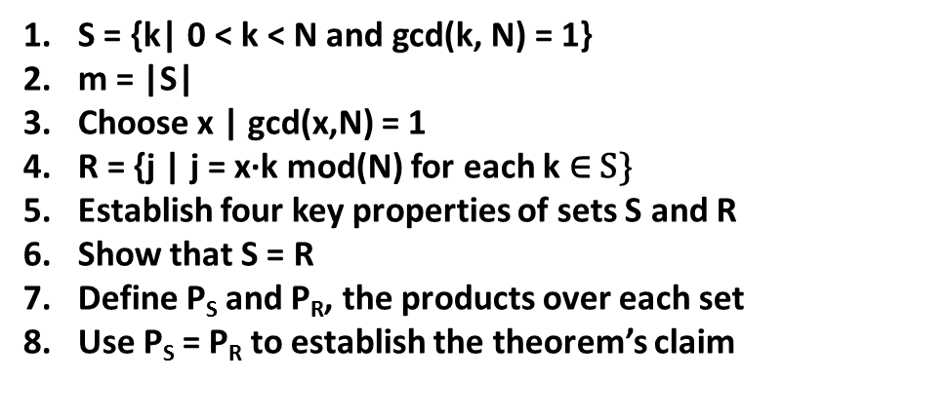
A proof in eight (mostly) simple steps
S = $\text{\{}\text{k}\text{| 0 < }\text{k}\text{ < }\text{N} \text{and} \text{gcd}\text{(}\text{k}\text{, }\text{N}\text{) = 1\}}$
m = |S|
Choose x | gcd(x,N) = 1
R = {j | j = x·k mod(N) for each k ∈ S}
Establish four key properties of sets S and R
Show that S = R
Define P_{S} and P_{R}, the products over each set
Use P_{S} = P_{R} to establish the theorem’s claim
INSERT
VIDEO
HERE

Slide 35
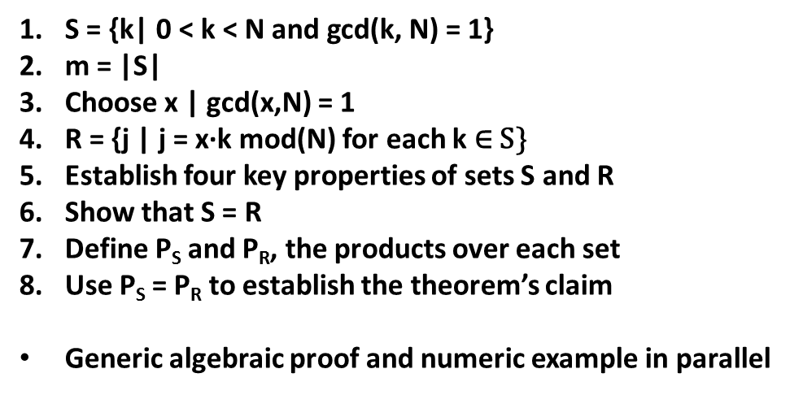
A proof in eight (mostly) simple steps
S = $\text{\{}\text{k}\text{| 0 < }\text{k}\text{ < }\text{N} \text{and} \text{gcd}\text{(}\text{k}\text{, }\text{N}\text{) = 1\}}$
m = |S|
Choose x | gcd(x,N) = 1
R = {j | j = x·k mod(N) for each k ∈ S}
Establish four key properties of sets S and R
Show that S = R
Define P_{S} and P_{R}, the products over each set
Use P_{S} = P_{R} to establish the theorem’s claim
Generic algebraic proof and numeric example in parallel
INSERT
VIDEO
HERE

Slide 36

Step 1: S = $\text{\{}\text{k}\text{| 0 < }\text{k}\text{ < }\text{N} \text{and} \text{gcd}\text{(}\text{k}\text{, }\text{N}\text{) = 1\}}$
INSERT
VIDEO
HERE

Slide 37
Step 1: S = $\text{\{}\text{k}\text{| 0 < }\text{k}\text{ < }\text{N} \text{and} \text{gcd}\text{(}\text{k}\text{, }\text{N}\text{) = 1\}}$
N = 21
INSERT
VIDEO
HERE

Slide 38
Step 1: S = $\text{\{}\text{k}\text{| 0 < }\text{k}\text{ < }\text{N} \text{and} \text{gcd}\text{(}\text{k}\text{, }\text{N}\text{) = 1\}}$
N = 21
S = {1, 2, 4, 5, 8, 10, 11, 13, 16, 17, 19, 20}
INSERT
VIDEO
HERE

Slide 39
Step 2: m = |S|
N = 21
S = {1, 2, 4, 5, 8, 10, 11, 13, 16, 17, 19, 20}
INSERT
VIDEO
HERE

Slide 40
Step 2: m = |S|
N = 21
S = {1, 2, 4, 5, 8, 10, 11, 13, 16, 17, 19, 20}
m = |S| = 12
INSERT
VIDEO
HERE

Slide 41
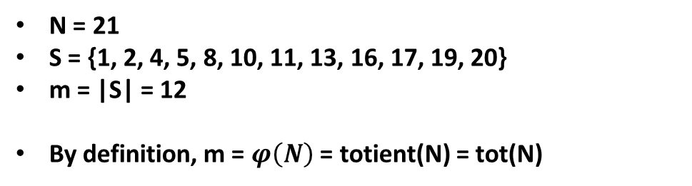
Step 2: m = |S|
N = 21
S = {1, 2, 4, 5, 8, 10, 11, 13, 16, 17, 19, 20}
m = |S| = 12
By definition, m = $φ\left(N\right)$ = totient(N) = tot(N)
INSERT
VIDEO
HERE

Slide 42
Step 3: Choose x | gcd(x,N) = 1
N = 21
S = {1, 2, 4, 5, 8, 10, 11, 13, 16, 17, 19, 20}
m = |S| = 12
INSERT
VIDEO
HERE

Slide 43
Step 3: Choose x | gcd(x,N) = 1
N = 21
S = {1, 2, 4, 5, 8, 10, 11, 13, 16, 17, 19, 20}
m = |S| = 12
x = 5
INSERT
VIDEO
HERE

Slide 44
Step 4: R = {j | j = x·k mod(N) for each k ∈ S}
N = 21
S = {1, 2, 4, 5, 8, 10, 11, 13, 16, 17, 19, 20}
m = |S| = 12
x = 5
INSERT
VIDEO
HERE

Slide 45
Step 4: R = {j | j = x·k mod(N) for each k ∈ S}
N = 21
S = {1, 2, 4, 5, 8, 10, 11, 13, 16, 17, 19, 20}
m = |S| = 12
x = 5
R = {5, 10, 20, 4, 19, 8, 13, 2, 17, 1, 11, 16}
INSERT
VIDEO
HERE

Slide 46
Step 5: Establish four key properties of sets S and R
INSERT
VIDEO
HERE

Slide 47
Step 5: Establish four key properties of sets S and R
All elements of S are distinct
INSERT
VIDEO
HERE

Slide 48
Step 5: Establish four key properties of sets S and R
All elements of S are distinct
Self-evident by nature of construction
INSERT
VIDEO
HERE

Slide 49
Step 5: Establish four key properties of sets S and R
All elements of S are distinct
Self-evident by nature of construction
|S| = |R| = m
INSERT
VIDEO
HERE

Slide 50
Step 5: Establish four key properties of sets S and R
All elements of S are distinct
Self-evident by nature of construction
|S| = |R| = m
Self-evident by nature of construction
INSERT
VIDEO
HERE

Slide 51
Step 5: Establish four key properties of sets S and R
All elements of S are distinct
Self-evident by nature of construction
|S| = |R| = m
Self-evident by nature of construction
R ⊆ S
INSERT
VIDEO
HERE

Slide 52
Step 5: Establish four key properties of sets S and R
All elements of S are distinct
Self-evident by nature of construction
|S| = |R| = m
Self-evident by nature of construction
R ⊆ S
Proof by contradiction
INSERT
VIDEO
HERE

Slide 53
Step 5: Establish four key properties of sets S and R
All elements of S are distinct
Self-evident by nature of construction
|S| = |R| = m
Self-evident by nature of construction
R ⊆ S
Proof by contradiction
All elements of S are distinct
INSERT
VIDEO
HERE

Slide 54
Step 5: Establish four key properties of sets S and R
All elements of S are distinct
Self-evident by nature of construction
|S| = |R| = m
Self-evident by nature of construction
R ⊆ S
Proof by contradiction
All elements of S are distinct
Proof by contradiction
INSERT
VIDEO
HERE

Slide 55
Step 5.3: All elements in R are also in S
INSERT
VIDEO
HERE

Slide 56
Step 5.3: All elements in R are also in S
All element in R are non-negative integers less than N
INSERT
VIDEO
HERE

Slide 57
Step 5.3: All elements in R are also in S
All element in R are non-negative integers less than N
Any element relatively prime to N must also be in S
INSERT
VIDEO
HERE

Slide 58
Step 5.3: All elements in R are also in S
All element in R are non-negative integers less than N
Any element relatively prime to N must also be in S
Assume j ∈ R | gcd(j, N) = d where d > 1
INSERT
VIDEO
HERE

Slide 59
Step 5.3: All elements in R are also in S
All element in R are non-negative integers less than N
Any element relatively prime to N must also be in S
Assume j ∈ R | gcd(j, N) = d where d > 1
j = k·x mod N where k ∈ S
INSERT
VIDEO
HERE

Slide 60
Step 5.3: All elements in R are also in S
All element in R are non-negative integers less than N
Any element relatively prime to N must also be in S
Assume j ∈ R | gcd(j, N) = d where d > 1
j = k·x mod N where k ∈ S
j = k·x + q·N (0 ≤ j < N)
INSERT
VIDEO
HERE

Slide 61
Step 5.3: All elements in R are also in S
All element in R are non-negative integers less than N
Any element relatively prime to N must also be in S
Assume j ∈ R | gcd(j, N) = d where d > 1
j = k·x mod N where k ∈ S
j = k·x + q·N (0 ≤ j < N)
c₁·d = k·x + q·c₂·d
INSERT
VIDEO
HERE

Slide 62
Step 5.3: All elements in R are also in S
All element in R are non-negative integers less than N
Any element relatively prime to N must also be in S
Assume j ∈ R | gcd(j, N) = d where d > 1
j = k·x mod N where k ∈ S
j = k·x + q·N (0 ≤ j < N)
c₁·d = k·x + q·c₂·d
c₁ = k·x/d + q·c₂
INSERT
VIDEO
HERE

Slide 63
Step 5.3: All elements in R are also in S
All element in R are non-negative integers less than N
Any element relatively prime to N must also be in S
Assume j ∈ R | gcd(j, N) = d where d > 1
j = k·x mod N where k ∈ S
j = k·x + q·N (0 ≤ j < N)
c₁·d = k·x + q·c₂·d
c₁ = k·x/d + q·c₂
gcd(j, N) = 1 (contradiction!)
INSERT
VIDEO
HERE

Slide 64
Step 5.3: All elements in R are also in S
All element in R are non-negative integers less than N
Any element relatively prime to N must also be in S
Assume j ∈ R | gcd(j, N) = d where d > 1
j = k·x mod N where k ∈ S
j = k·x + q·N (0 ≤ j < N)
c₁·d = k·x + q·c₂·d
c₁ = k·x/d + q·c₂
gcd(j, N) = 1 (contradiction!)
If j ∈ R then j ∈ S, thus R ⊆ S
INSERT
VIDEO
HERE

Slide 65
Step 5.4: All elements in R are distinct
INSERT
VIDEO
HERE

Slide 66
Step 5.4: All elements in R are distinct
Assume that j₁, j₂ ∈ R exist such that j₁ = j₂
INSERT
VIDEO
HERE

Slide 67
Step 5.4: All elements in R are distinct
Assume that j₁, j₂ ∈ R exist such that j₁ = j₂
j₁ ≡ k₁·x (mod N) and j₂ ≡ k₂·x (mod N)
INSERT
VIDEO
HERE

Slide 68
Step 5.4: All elements in R are distinct
Assume that j₁, j₂ ∈ R exist such that j₁ = j₂
j₁ ≡ k₁·x (mod N) and j₂ ≡ k₂·x (mod N)
j₁ = j₂ ⇒ j₁ ≡ j₂ (mod N)
INSERT
VIDEO
HERE

Slide 69
Step 5.4: All elements in R are distinct
Assume that j₁, j₂ ∈ R exist such that j₁ = j₂
j₁ ≡ k₁·x (mod N) and j₂ ≡ k₂·x (mod N)
j₁ = j₂ ⇒ j₁ ≡ j₂ (mod N)
k₁·x ≡ k₂·x (mod N)
INSERT
VIDEO
HERE

Slide 70
Step 5.4: All elements in R are distinct
Assume that j₁, j₂ ∈ R exist such that j₁ = j₂
j₁ ≡ k₁·x (mod N) and j₂ ≡ k₂·x (mod N)
j₁ = j₂ ⇒ j₁ ≡ j₂ (mod N)
k₁·x ≡ k₂·x (mod N)
x⁻¹ (mod N) exists
INSERT
VIDEO
HERE

Slide 71
Step 5.4: All elements in R are distinct
Assume that j₁, j₂ ∈ R exist such that j₁ = j₂
j₁ ≡ k₁·x (mod N) and j₂ ≡ k₂·x (mod N)
j₁ = j₂ ⇒ j₁ ≡ j₂ (mod N)
k₁·x ≡ k₂·x (mod N)
x⁻¹ (mod N) exists
k₁ ≡ k₂ (mod N)
INSERT
VIDEO
HERE

Slide 72
Step 5.4: All elements in R are distinct
Assume that j₁, j₂ ∈ R exist such that j₁ = j₂
j₁ ≡ k₁·x (mod N) and j₂ ≡ k₂·x (mod N)
j₁ = j₂ ⇒ j₁ ≡ j₂ (mod N)
k₁·x ≡ k₂·x (mod N)
x⁻¹ (mod N) exists
k₁ ≡ k₂ (mod N)
All k | 0 ≤ k < N are in distinct residue classes.
INSERT
VIDEO
HERE

Slide 73
Step 5.4: All elements in R are distinct
Assume that j₁, j₂ ∈ R exist such that j₁ = j₂
j₁ ≡ k₁·x (mod N) and j₂ ≡ k₂·x (mod N)
j₁ = j₂ ⇒ j₁ ≡ j₂ (mod N)
k₁·x ≡ k₂·x (mod N)
x⁻¹ (mod N) exists
k₁ ≡ k₂ (mod N)
All k | 0 ≤ k < N are in distinct residue classes.
k₁ = k₂ (contradiction!)
INSERT
VIDEO
HERE

Slide 74
Step 5.4: All elements in R are distinct
Assume that j₁, j₂ ∈ R exist such that j₁ = j₂
j₁ ≡ k₁·x (mod N) and j₂ ≡ k₂·x (mod N)
j₁ = j₂ ⇒ j₁ ≡ j₂ (mod N)
k₁·x ≡ k₂·x (mod N)
x⁻¹ (mod N) exists
k₁ ≡ k₂ (mod N)
All k | 0 ≤ k < N are in distinct residue classes.
k₁ = k₂ (contradiction!)
j₁ ≢ j₂ (mod N) ⇒ All j ∈ R are distinct
INSERT
VIDEO
HERE

Slide 75
Step 6: Show that S = R
INSERT
VIDEO
HERE

Slide 76
Step 6: Show that S = R
All elements of S are distinct
INSERT
VIDEO
HERE

Slide 77
Step 6: Show that S = R
All elements of S are distinct
|S| = |R| = m
INSERT
VIDEO
HERE

Slide 78
Step 6: Show that S = R
All elements of S are distinct
|S| = |R| = m
R ⊆ S
INSERT
VIDEO
HERE

Slide 79
Step 6: Show that S = R
All elements of S are distinct
|S| = |R| = m
R ⊆ S
All elements of S are distinct
INSERT
VIDEO
HERE

Slide 80
Step 6: Show that S = R
All elements of S are distinct
|S| = |R| = m
R ⊆ S
All elements of S are distinct
S ⊆ R by pigeonhole principle
INSERT
VIDEO
HERE

Slide 81
Step 6: Show that S = R
All elements of S are distinct
|S| = |R| = m
R ⊆ S
All elements of S are distinct
S ⊆ R by pigeonhole principle
R ⊆ S and S ⊆ R ⇒ R = S
INSERT
VIDEO
HERE

Slide 82
Step 7: Define P_{S} and P_{R}, the products over each set
INSERT
VIDEO
HERE

Slide 83

Step 7: Define P_{S} and P_{R}, the products over each set
$$P_{S}=\prod_{i=1}^{m}{k_{i}}$$
INSERT
VIDEO
HERE

Slide 84

Step 7: Define P_{S} and P_{R}, the products over each set
$$P_{S}=\prod_{i=1}^{m}{k_{i}}$$
$$P_{R}=\prod_{i=1}^{m}{j_{i}}$$
INSERT
VIDEO
HERE

Slide 85

Step 7: Define P_{S} and P_{R}, the products over each set
$$P_{S}=\prod_{i=1}^{m}{k_{i}}$$
$$P_{R}=\prod_{i=1}^{m}{j_{i}}$$
Example: P_{S} = P_{R} = 47,297,536,000
INSERT
VIDEO
HERE

Slide 86
Step 8: Use P_{S} = P_{R} to establish the theorem’s claim
INSERT
VIDEO
HERE

Slide 87
Step 8: Use P_{S} = P_{R} to establish the theorem’s claim
$$P_{S}=P_{R}$$
INSERT
VIDEO
HERE

Slide 88
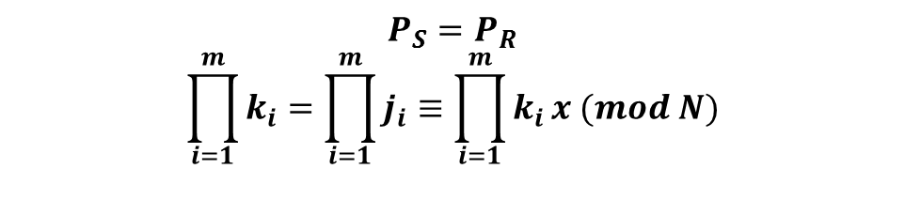
Step 8: Use P_{S} = P_{R} to establish the theorem’s claim
$$P_{S}=P_{R}$$
$$\prod_{i=1}^{m}{k_{i}}=\prod_{i=1}^{m}{j_{i}}≡\prod_{i=1}^{m}{k_{i}}x (mod N)$$
INSERT
VIDEO
HERE

Slide 89
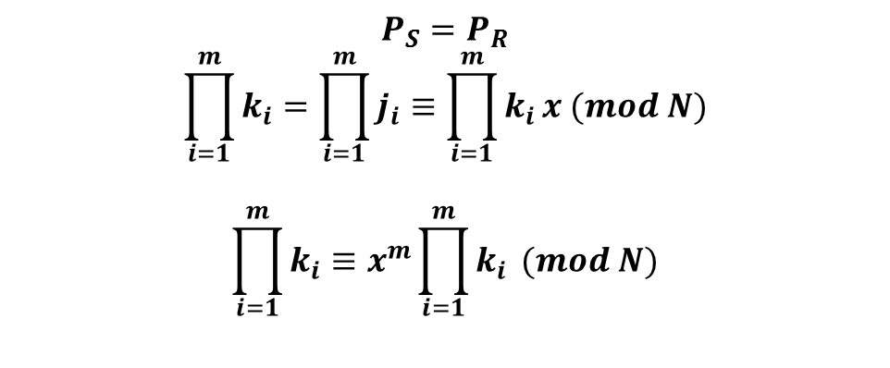
Step 8: Use P_{S} = P_{R} to establish the theorem’s claim
$$P_{S}=P_{R}$$
$$\prod_{i=1}^{m}{k_{i}}=\prod_{i=1}^{m}{j_{i}}≡\prod_{i=1}^{m}{k_{i}}x (mod N)$$
$$\prod_{i=1}^{m}{k_{i}}≡x^{m}\prod_{i=1}^{m}{k_{i}} (mod N)$$
INSERT
VIDEO
HERE

Slide 90
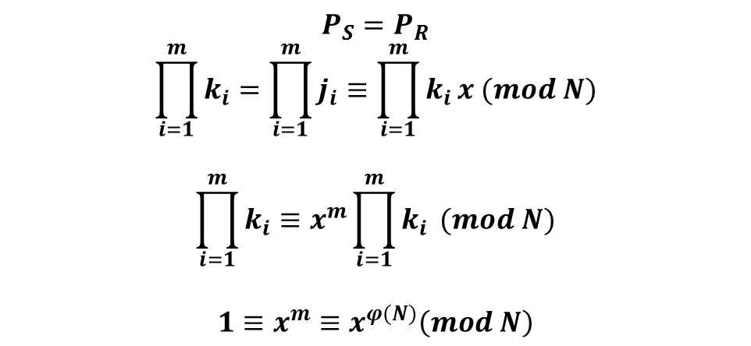
Step 8: Use P_{S} = P_{R} to establish the theorem’s claim
$$P_{S}=P_{R}$$
$$\prod_{i=1}^{m}{k_{i}}=\prod_{i=1}^{m}{j_{i}}≡\prod_{i=1}^{m}{k_{i}}x (mod N)$$
$$\prod_{i=1}^{m}{k_{i}}≡x^{m}\prod_{i=1}^{m}{k_{i}} (mod N)$$
$$1≡x^{m}≡x^{φ(N)}\left(mod N\right)$$
INSERT
VIDEO
HERE

Slide 91
The exponent lives in a mod-totient world – but only when the base is r.p. to the modulus
INSERT
VIDEO
HERE

Slide 92
The exponent lives in a mod-totient world – but only when the base is r.p. to the modulus
$$x^{y}=x^{qm+r}=x^{qm + y mod m}$$
INSERT
VIDEO
HERE

Slide 93

The exponent lives in a mod-totient world – but only when the base is r.p. to the modulus
$$x^{y}=x^{qm+r}=x^{qm + y mod m}$$
$$x^{y}=x^{qm}x^{y mod m}$$
INSERT
VIDEO
HERE

Slide 94

The exponent lives in a mod-totient world – but only when the base is r.p. to the modulus
$$x^{y}=x^{qm+r}=x^{qm + y mod m}$$
$$x^{y}=x^{qm}x^{y mod m}$$
$$x^{y}={\left(x^{m}\right)}^{q}x^{y mod m}$$
INSERT
VIDEO
HERE

Slide 95
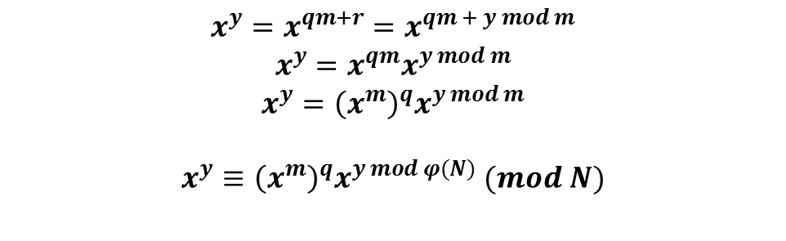
The exponent lives in a mod-totient world – but only when the base is r.p. to the modulus
$$x^{y}=x^{qm+r}=x^{qm + y mod m}$$
$$x^{y}=x^{qm}x^{y mod m}$$
$$x^{y}={\left(x^{m}\right)}^{q}x^{y mod m}$$
$$x^{y}≡{\left(x^{m}\right)}^{q}x^{y mod φ(N)} (mod N)$$
INSERT
VIDEO
HERE

Slide 96
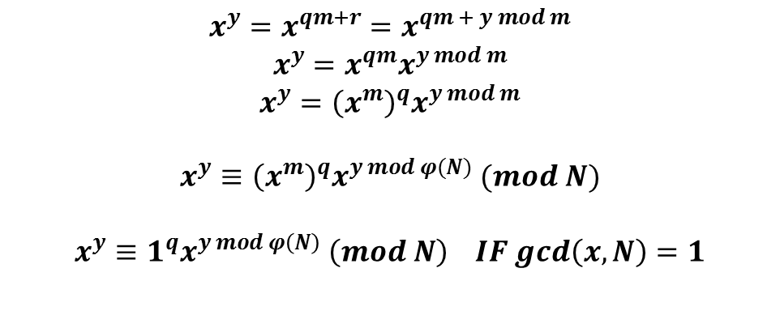
The exponent lives in a mod-totient world – but only when the base is r.p. to the modulus
$$x^{y}=x^{qm+r}=x^{qm + y mod m}$$
$$x^{y}=x^{qm}x^{y mod m}$$
$$x^{y}={\left(x^{m}\right)}^{q}x^{y mod m}$$
$$x^{y}≡{\left(x^{m}\right)}^{q}x^{y mod φ(N)} (mod N)$$
$$x^{y}≡1^{q}x^{y mod φ\left(N\right)} \left(mod N\right) IF gcd\left(x,N\right)=1$$
INSERT
VIDEO
HERE

Slide 97
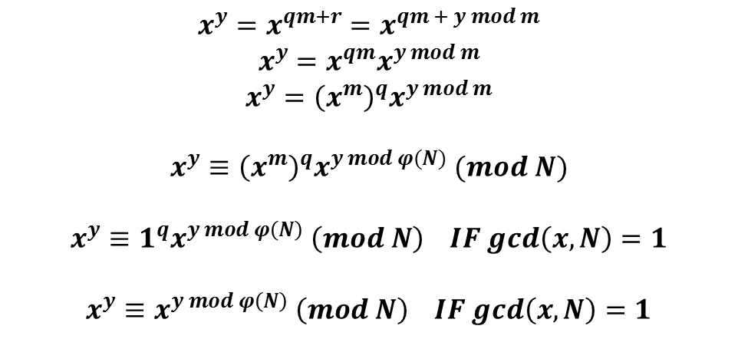
The exponent lives in a mod-totient world – but only when the base is r.p. to the modulus
$$x^{y}=x^{qm+r}=x^{qm + y mod m}$$
$$x^{y}=x^{qm}x^{y mod m}$$
$$x^{y}={\left(x^{m}\right)}^{q}x^{y mod m}$$
$$x^{y}≡{\left(x^{m}\right)}^{q}x^{y mod φ(N)} (mod N)$$
$$x^{y}≡1^{q}x^{y mod φ\left(N\right)} \left(mod N\right) IF gcd\left(x,N\right)=1$$
$$x^{y}≡x^{y mod φ\left(N\right)} \left(mod N\right) IF gcd\left(x,N\right)=1$$
INSERT
VIDEO
HERE

Slide 98
Don’t forget the fine print!
INSERT
VIDEO
HERE

Slide 99
Don’t forget the fine print!
In general
INSERT
VIDEO
HERE

Slide 100

Don’t forget the fine print!
In general
$$x^{y}≢x^{y mod φ\left(N\right)} \left(mod N\right)$$
INSERT
VIDEO
HERE

Slide 101

Don’t forget the fine print!
In general
$$x^{y}≢x^{y mod φ\left(N\right)} \left(mod N\right)$$
Congruence only holds when x, N are relatively prime!
INSERT
VIDEO
HERE

Slide 102
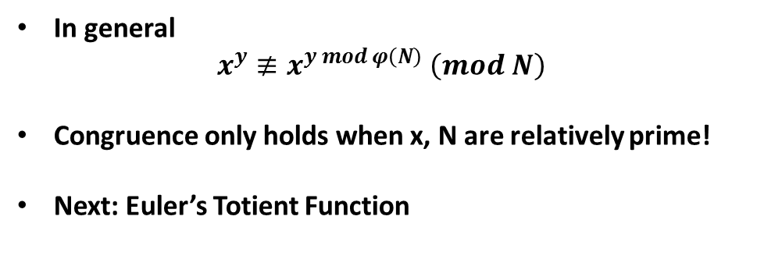
Don’t forget the fine print!
In general
$$x^{y}≢x^{y mod φ\left(N\right)} \left(mod N\right)$$
Congruence only holds when x, N are relatively prime!
Next: Euler’s Totient Function
INSERT
VIDEO
HERE

